Slide 1
ADMINISTRATION V/S MANAGEMENT

Slide 2
Are management and administration two distinct functions ?
There has been a controversy on the use of two terms – management and administration.
Several American writers consider them as two distinct functions while some other consider them as same.

Slide 3
According to Milward, both management and administration are two distinct terms. According to him, administration is a broder concept than management.
Administration is a top level function whereas management is a low level function.
Management is all about plans and actions, but the administration is concerned with framing and setting objectives.
The manager looks after the management of the organization, whereas administrator is responsible for the administration of the organization.

Slide 4
ADMINSTRATION
Administration means the overall determination of policies ,setting of major objectives , the identification of general purposes and laying down of broad programmes and projects.
The activities that relate to running an organisation

Slide 5
MANAGEMENT
Management is defined as an act of managing people and their work , for achieving a common goal by using the organisation resources.
Management is the act or function of putting into practice the policies and plans decided upon by the administration.

Slide 6
Administration v/s Management
Administration deals with the activities of higher level; setting up of objectives and crucial policies of the organisation.
Management involves conceiving , initiating and bringing together the various elements; coordinating, actuating, integrating the diverse organisational component while sustaining the viability of the organization towards some predetermined goals.
The difference can be summarized under two categories:
(a) Functions
(b) Usage/ Applicabilitiy

Slide 7
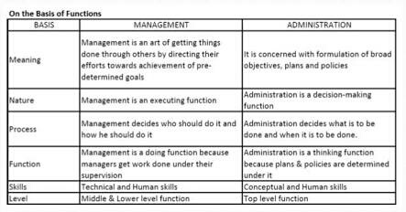

Slide 8
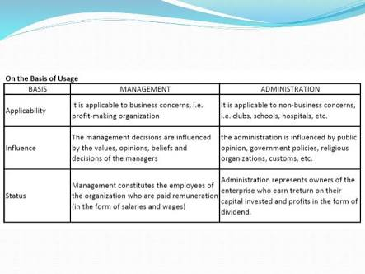

Slide 9
MANAGEMENT LEVEL:
ADMINISTRATIONS (THINKING)
MANAGEMENT (ORGANISING)
SUB-ORDINATES (DOING)
TOP LEVEL
MIDDLE LEVEL
LOW LEVEL

Slide 10
Feature of management:
Management is pervasive: Management is all pervasive that mean it is applicable everywhere ,as it has universal applications. It is required in all type of organization.
Management is goal oriented: An Organisation has a set of basic goal which are the basic reason for its existence .This should be simple and clearly stated. Different organization has different goals.
Management is multi dimensional: Management is a complex activity that has three main dimensions
(a)Management of work
(b) Management of people
(c)Management of operation

Slide 11
Management is a continuous process: Process of management is the series of continuous , composite, but separate functions (Planning, Organising, Staffing,Directing and Controlling). These functions are simultaneously performed by all managers all the time.
Management is a group activity: An organization is a collection of diverse individuals with different needs. Every member of the group has different needs for joining the organization but as a member of the organization they work towards fulfilling the common organizational goals.
Management is a dynamic function: Management is a dynamic function as it has to adapt itself to the changing environment. An organization interact with its external environment which consists of various social, economic and political factors.
Management is an intangible asset: Management is an intangible force that cannot be seen but its presence can be felt in the way the organization functions. The effects of management is noticeable in the organization where targets are met according to the plans, employees are happy and satisfied.

Slide 12
Feature of Administration
Planning:
Planning is deciding in advance what to do and how to do. It is one of the basic managerial functions. Before doing something, the manager must formulate an idea of how to work on a particular task. Thus, planning is closely connected with creativity and innovation.
Organising:
Organising involves a series of steps that need to be taken in order to achieve the desired goal. It is the process of identifying and grouping the work to be performed, defining and delegating responsibility and authority, and establishing relationship for the purpose of enabling people to work most effectively together in accomplishing objectives.

Slide 13
Staffing:
Staffing means “putting people to jobs”. Staffing fulfils requirement and finds the right people for the right work. It is a process which is concerned with obtaining, utilizing and maintaining a satisfactory and satisfied work force.
Directing:
Plans are of no use until they get executed. Process of executing involves guiding, coaching, instructing, motivating, leading the people in an organization to achieve organizational objectives.

Slide 14
Controlling:
In order to seek planned results from the subordinates, a manager needs to exercise effective control over the activities of the subordinates.
Controlling means ensuring that activities in an organization are performed as per the plans. It also ensures that organization’s resources are being used effectively and efficiently for the achievement of pre determined goals.

Slide 15
Efficiency and Effectiveness
In order to be a manager, a person must know the best ways to make a business be more efficient and more effective. This is one of the most important thing a manager can do.
Efficiency is the ability to avoid wasting materials, energy, efforts, money and time in doing something or in producing a desired result.
Effectiveness is the capability of producing desired results or the ability of producing desired outputs irrespective of the resources used.

Slide 16
Conclusion:
Practically there is no difference between management and administration. Every manager is concerned with both administrative management function and operative management function. However, the managers who are higher up in the hierarchy denote more time to administrative function and lower level denote more time on directing and controlling worker’s performance i.e., management.

Slide 17
Presented by:
1.Shikha (2018PGCACA45)
2. Nisha Sharma (2018PGCACA46)
3. Nitu Nivedita (2018PGCACA48)
4. Anju Hembrom (2018PGCACA49)
5. Bhawna Badlani (2018PGCACA53)
6. Aparna Yaduvanshi (2018PGCACA65)
7. Tanvi Gupta (20188PGCACA73)

